Slide 1

Web Project for Exchange Student
SKKUEXS
김주원 | 서현원 | 이하은 | 한희근

Slide 2
Schedule
To – do Week | 3 | 4 | 5 | 6 | 7 | 8 | 9 | 10 | 11 | 12 | 13 | 14 | 15
Proposal & Study
Data Collecting
Data Processing (NLP)
Front-end (Planning & UI/UX)
Back-end (Server & DB Design)
Beta Test
2

Slide 3
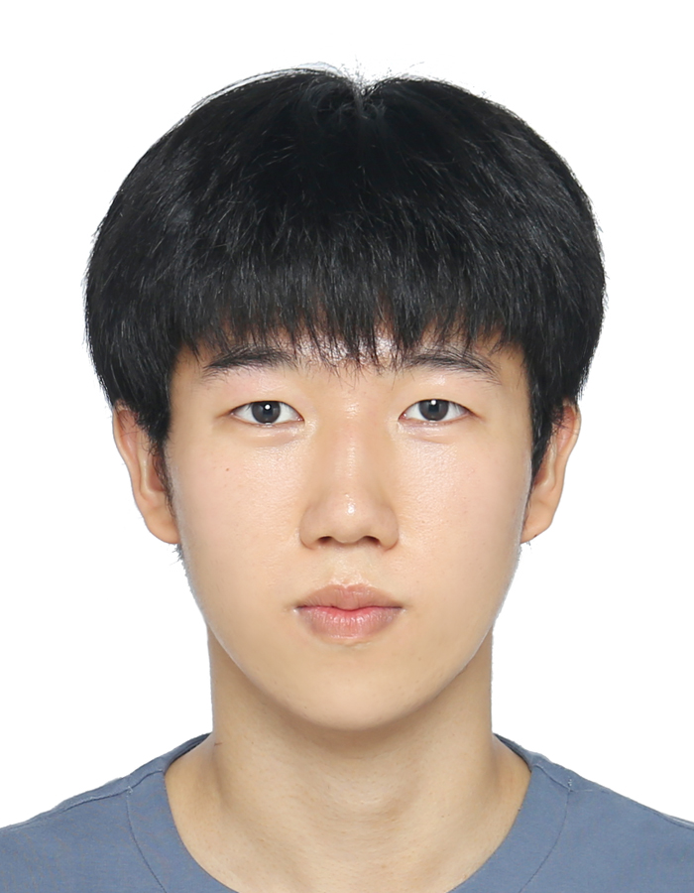
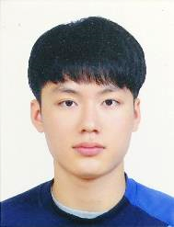
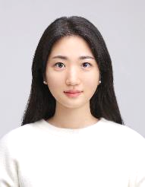
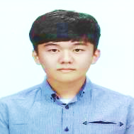
Work Assignment
Juwon Kim
DB Deployment
Hyunwon Seo
Social Login
Haeun Lee
Front-end Implementation
Huigeun Han
Front-end Implementation
3

Slide 4
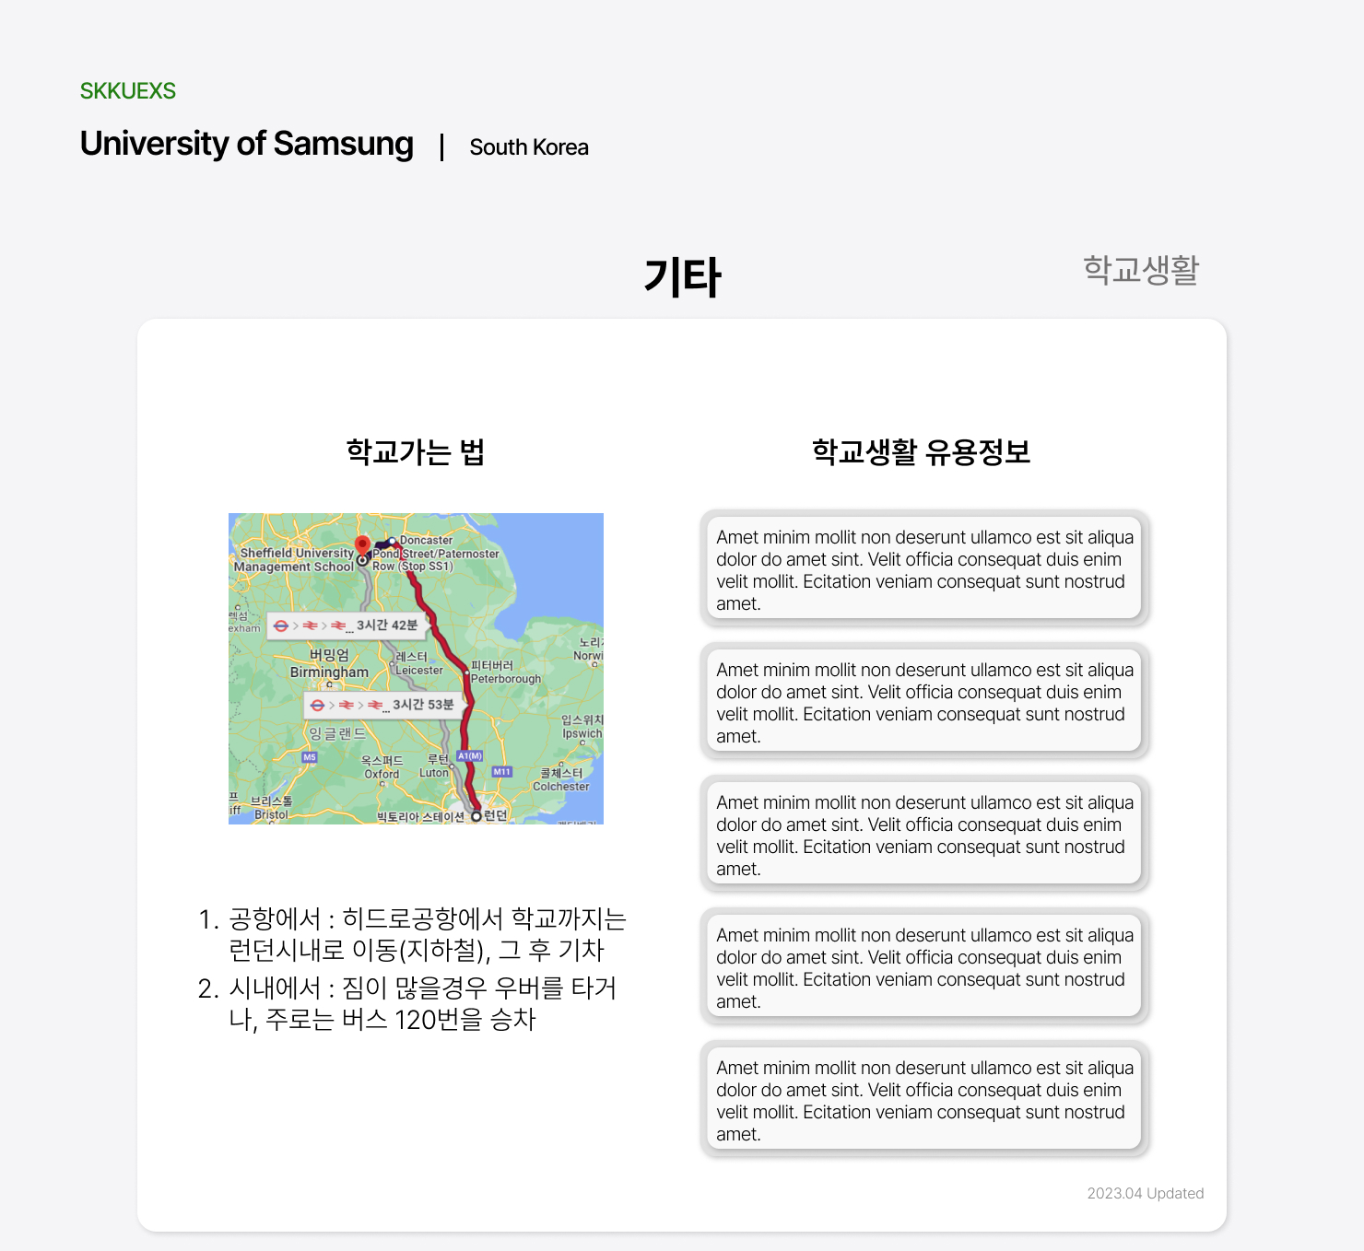
Uni Life Etc Page added
4

Slide 5
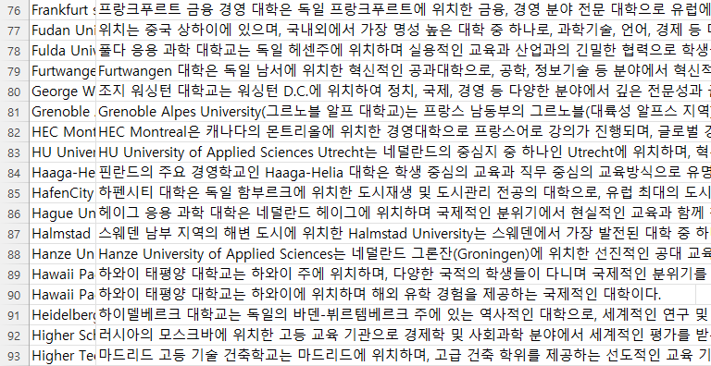

Short summary using Open AI API
Using GPT API automatically showing on website
long loading time
Getting refreshed every time
Users given with different information
5

Slide 6
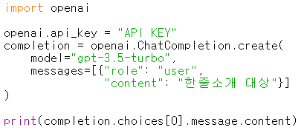
Short summary using Open AI API
So, result of using GPT into DB
6

Slide 7
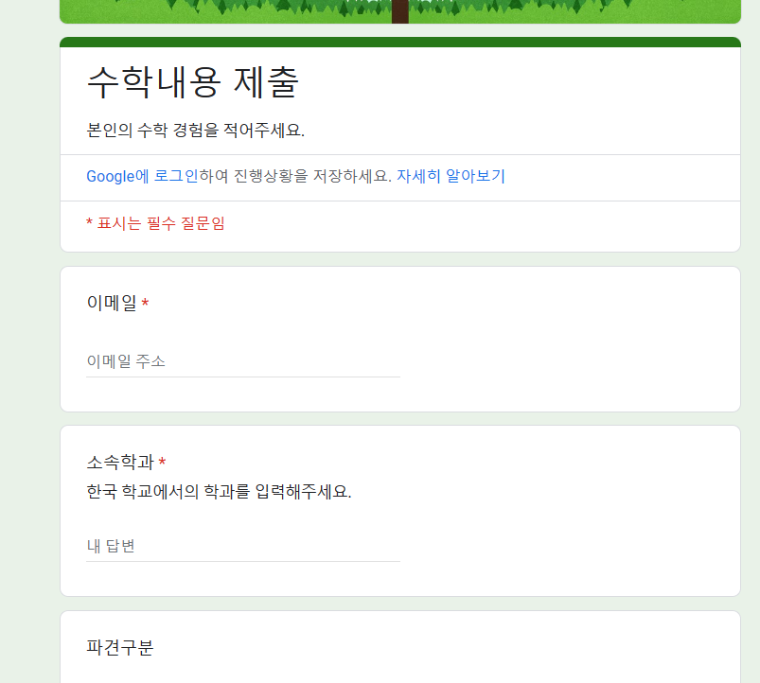
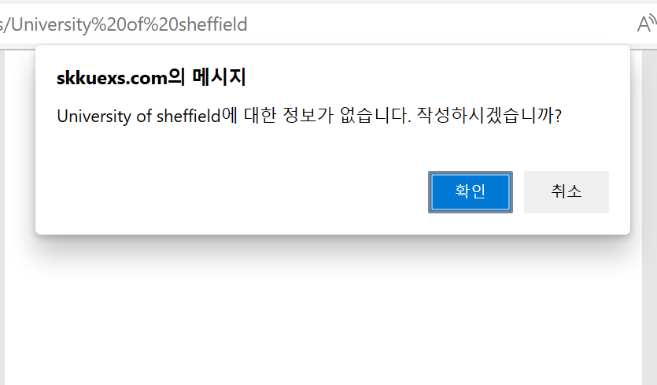
Getting Form about NULL School
University of Sheffield (skkuexs.com)
7

Slide 8
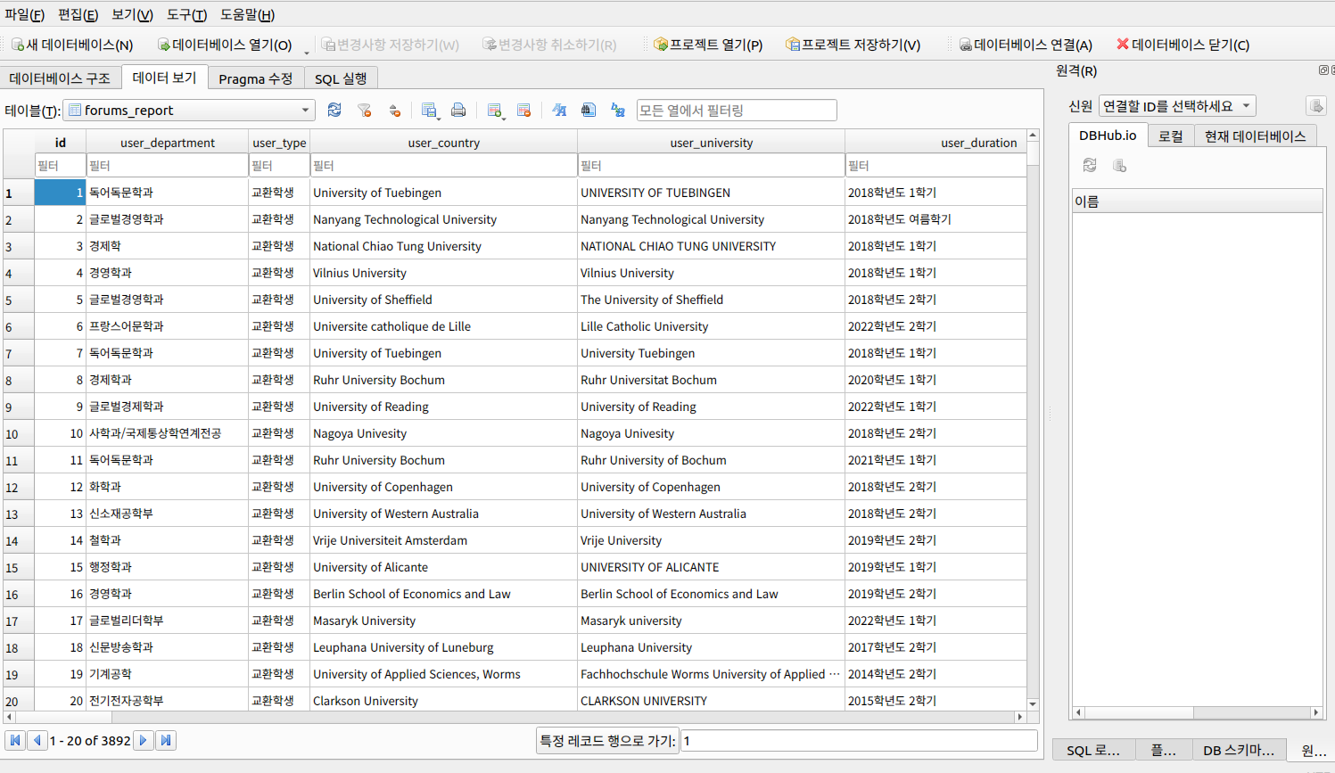
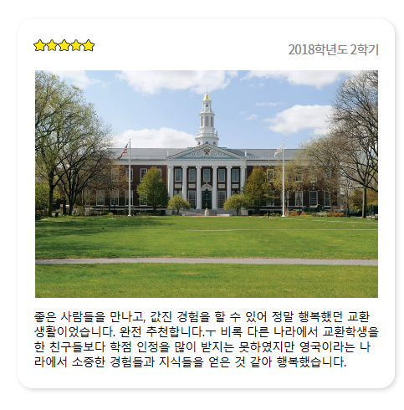
DB Implementation
8

Slide 9
Demo
Link
Ex) University of Leeds
9

